Slide 1
eBabyCare
Presented By Jannatul Ferdous Shova
GO!

Slide 2
Initiation
Presented By
Supervising by
Jannatul Ferdous Shova
182-35-2568(26th Batch)
Department of Software Engineering, FSIT
Daffodil International University
Md. Shohel Arman
Senior Lecturer
Department of Software Engineering, FSIT
Daffodil International University

Slide 3
DECLARATION
I hereby declare that I have taken this project under the supervision of Md. Shohel Armaan, Lecturer, Department of Software Engineering, Daffodil International University. I also declare that this project doesn’t have been submitted elsewhere for the award of any degree.

Slide 5
Presentation Overview
02
04
01
03
Table of contents
Technologies
Functional & Non Functional Requirements
Project Overview
Stakeholders

Slide 6
Presentation Overview
06
08
05
07
Table of contents
Activity Diagram
ERD Diagram
Use Case Diagram
Sequence Diagram

Slide 7
01
Project Overview
Table of contents

Slide 8
Project Overview - Background
In today’s world, raising up a child is a great issue for the working parents. In most cases finding a nanny or trustable a helping hand is extremely difficult to find. On the other hand, still there are no part-times job sectors for our high-school kids and college kids as well(14 or above). Most of them are matured enough to take care of an toddler or young kids. My project “eBabyCare” is going to make a bridge between these two. It will help these parents to find a trustable person for a certain period of time and help those kids to earn some pocket money by taking care of a baby.

Slide 9
Project Overview - Goals
Create Account
Apply for Nanny
Pay Online
Both nanny and Client/parent can create account
Client can apply for nanny
make bKash /rocket/online payment gateway

Slide 10
Project Overview - Goals
Control
Set Time
Feedback
Administrator can control the list of Nannies and Parents
Allows Clients to choose time of baby care
Client and Nannies can give a feedback

Slide 11
Project Overview - Gantt Chart
 | January |  | February |  | March |  | April |  | May
Proposal
Supervisor Assign
Project Discussion & Mid Defense
System Analysis
Design
Implementation
Testing
Deploy

Slide 12
02
Technologies
Table of contents

Slide 13
Frontend
React JS
CSS
Bootstrap
Material UI
Backend
Express JS
Rest API
Database
Firebase
Mongo DB

Slide 14
03
Stakeholders
Table of contents

Slide 15



Client
Admin
Nanny

Slide 16
Process Flow
Parents
Apply for a nanny
Make Payment
Admin
Manage Clients
Nannies
Confirm Task
Manage Nannies
Manage Payments
Receive Payment

Slide 17
04
Functional & Non Functional Requirements
Table of contents

Slide 18
Functional & Non Functional Requirements
Functional
01
Table of contents
02
03
Non- Functional
Registration/ Login
Create Account
Apply For a Nanny
Sent Notification
Appoint Nanny
Make Payment
Response To Notification
Give Feedback
Usability
Security
Maintainability

Slide 19
05
Use Case Diagram
Table of contents

Slide 20
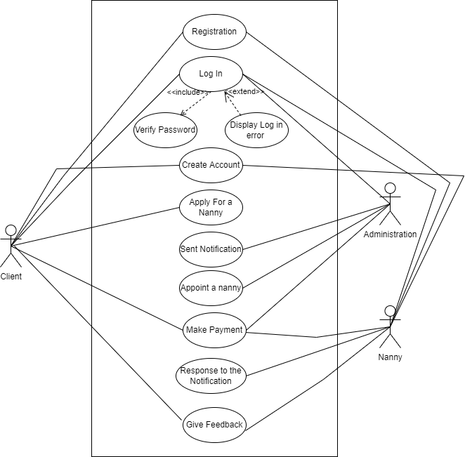
Use Case

Slide 21
06
Activity Diagram
Table of contents

Slide 22
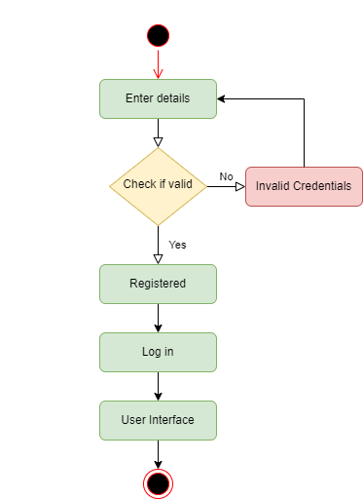
Registration

Slide 23
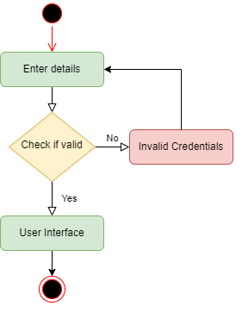
Log In

Slide 24
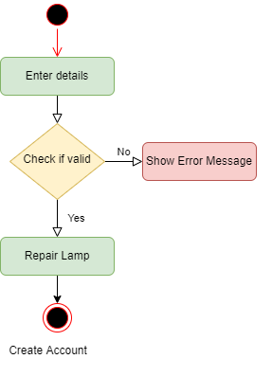
Create Account

Slide 25
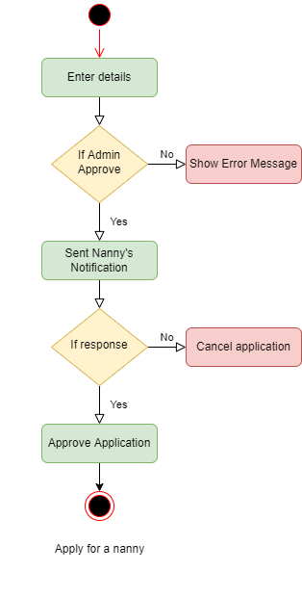
Apply For a Nanny

Slide 26
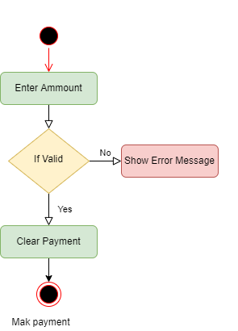
Make Payment

Slide 27
07
Sequence Diagram
Table of contents

Slide 28
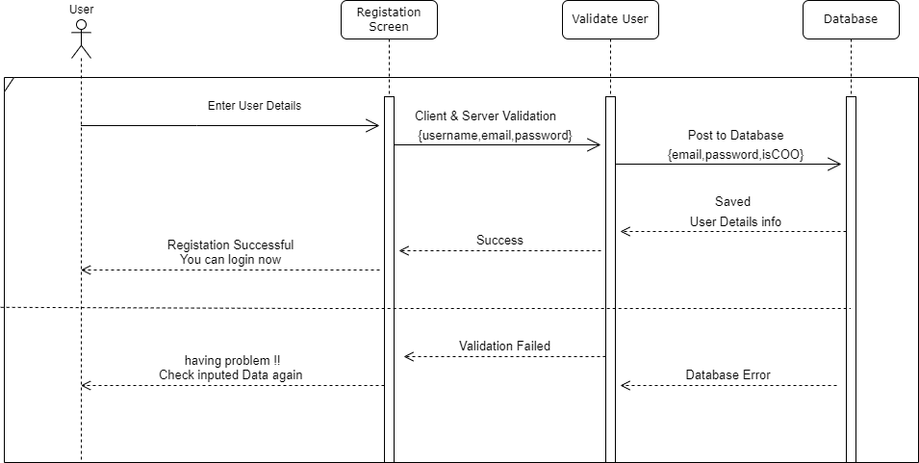
Registration

Slide 29
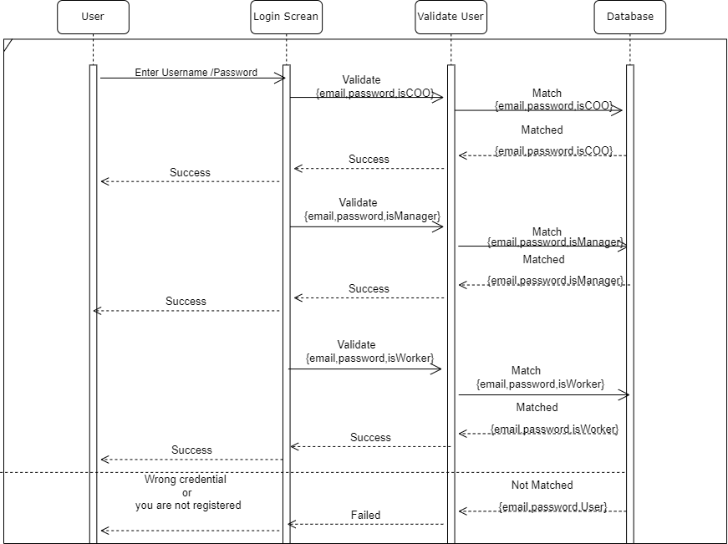
Log In

Slide 30
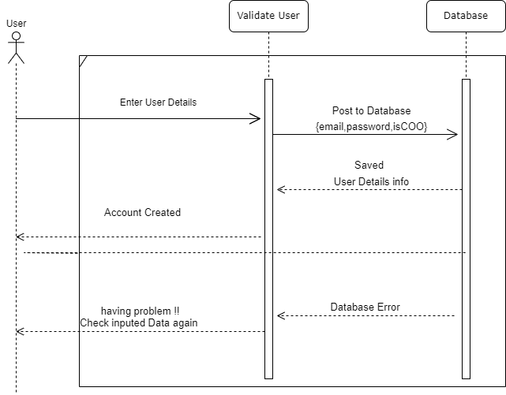
Create Account

Slide 31
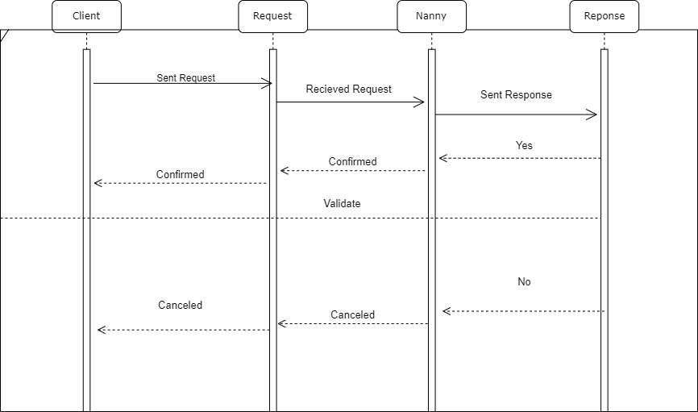
Find a Nanny

Slide 32

Make Payment

Slide 33
08
ERD Diagram
Table of contents

Slide 34
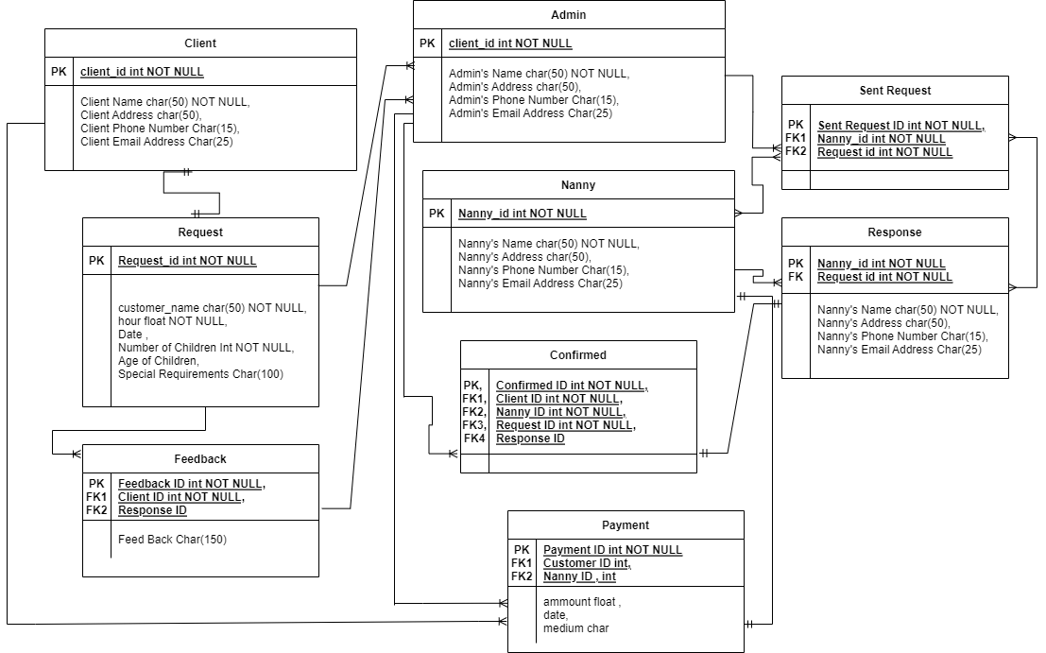

Slide 41
Limitation
I have tried my best to make this website better and fulfil requirements but some of them could not be possible for this stage.
On my website, there is some search option issues
Future Scope
We are thinking of some modifications and adding some advanced new features to our system. Like:
More user friendly.
Add more information with one search

Slide 42
Thank You

